Slide 1

Why Be Pure?
1 Corinthians 6:12-20
Dr. Rick Griffith • Crossroads International Church Singapore
cicfamily.com & BibleStudyDownloads.org

Slide 2
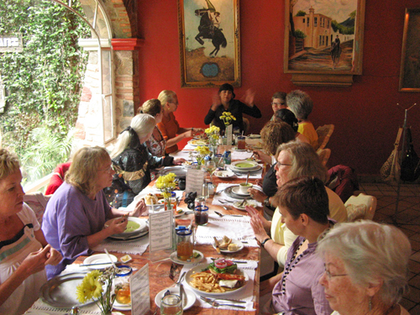
One day at lunch…

Slide 3
Black
Notes:
3

Slide 4

4-Star General David Petraeus
Notes:
David Petraeus is one of the most decorated men in all the US military—a rare 4-star general. He is credited with the successful exit of the US troops from Iraq, and also has a sterling reputation for his leadership in Afghanistan.

Slide 5

Avoid sexual immorality
CIA Director David Petraeus
Notes:
President Obama made him his CIA chief, but two days ago (9 Nov 2012) Petraeus wrote, "Yesterday afternoon, I went to the White House and asked the President to be allowed, for personal reasons, to resign from my position as D/CIA," Petraeus wrote. "After being married for over 37 years, I showed extremely poor judgment by engaging in an extramarital affair. Such behavior is unacceptable, both as a husband and as the leader of an organization such as ours. This afternoon, the President graciously accepted my resignation."

Slide 6

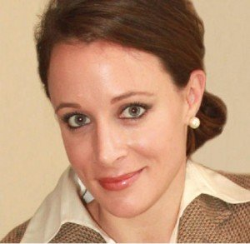
Biographer Paula Broadwell
Notes:
The woman with whom the 60-year old committed adultery after 37 years of marriage is, ironically, his biographer, Paula Broadwell. She wrote a glowing book about him and was embedded with him in Afghanistan. Now she is embedded with him in controversy and shame.

Slide 7
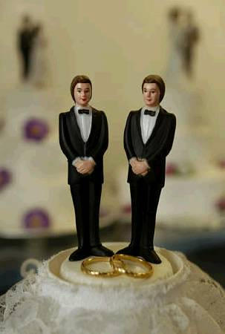

Sodomite "Marriage"
Notes:
Up to November 2012, in the USA 32 states voted in favor of marriage. However, on 6 Nov 2012 (last Tuesday), for the first time, the definition of marriage was redefined to include sodomites. Amazingly, 4 states narrowly passed this redefinition: Maine, Maryland, Minnesota, and Washington. This is the first time a popular vote has redefined marriage in the USA.

Slide 8
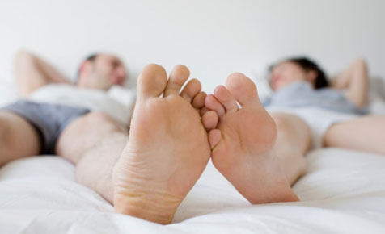
Avoid sexual immorality
"The body is not meant for sexual immorality" (6:13)
"Flee from sexual immorality" (6:18)
Subject of 1 Corinthians 6:12-20

Slide 9

Marital Intimacy
fornication
homosexuality
adultery
Sexual Immorality
(pornea)

Slide 10

Why limit God's gift to only one person?

Slide 11

Socrates on Marriage…
"By all means, marry.
If you get a good wife, you'll become happy;
if you get a bad one, you'll become a philosopher."
www.brainyquote.com
Notes:
http://www.brainyquote.com/quotes/quotes/s/socrates163765.html

Slide 12
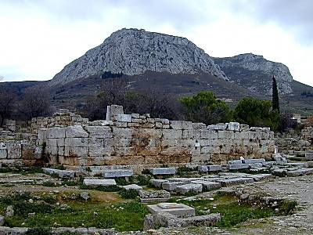
“To Corinthianize”
Notes:
12

Slide 13
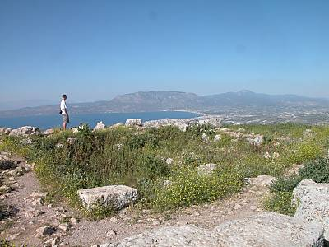
“To San Franciscoize”
Notes:
13

Slide 14
The Wayward Local Church
The Wayward Local Church
Reports
Questions
Division
Disorder
Difficulties
Concern
1–4
Discipline
5–6
Instruction
7–16
Carnality
3–4
Marriage 7
Worship
11–14
Factions 1–2
Incest 5
Idols 8–10
Resurrection
15
Immorality
Collection 16
Lawsuits 6
Solving church problems theologically

Slide 15
Why limit God's gift to only one person?
3 reasons…

Slide 16

I. Immorality harms your relationship with God
(12-14, 17, 19-20)
Why purity?

Slide 17
God or immorality?
A. Immorality enslaves you rather than frees you for God's use (12).

Slide 18

JUST DO IT.

Slide 19
God or immorality?
A. Immorality enslaves you rather than frees you for God's use (12).
B. Immorality misuses your body dedicated to God's use (13).
C. Immorality involves a body destined for glory (14).

Slide 20

Religion Professor Survey
Is premarital sex OK?
Yes
60%
No
40%
1984 survey of 950 religion dept. faculty members, USA

Slide 21
God or immorality?
A. Immorality enslaves you rather than frees you for God's use (12).
B. Immorality misuses your body dedicated to God's use (13).
C. Immorality involves a body destined for glory (14).
D. Immorality destroys your unity with Christ (17).
E. Immorality dishonors God's temple since His Spirit lives in you (19-20).

Slide 22
“Now the earth formless and empty, darkness was over the the surface of the deep…”
“…and the Spirit of God was hovering over the waters.”
Genesis 1:2 NIV

Slide 23
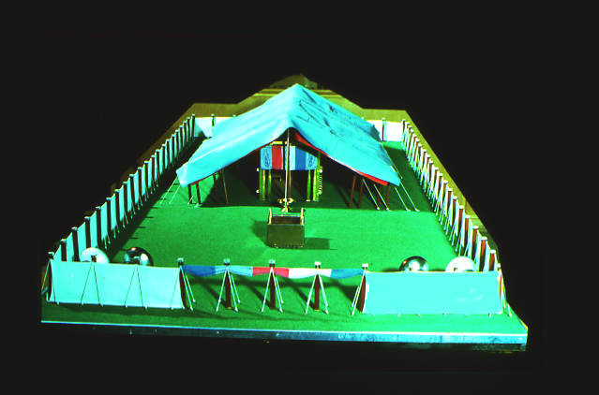
The Tabernacle
7
God sets up a place for Him to dwell as King
MOSES
Exodus
Sinai
M - C - C
Kadesh Barnea
40
The Tabernacle in the Wilderness
Handbook pg. 26-29
2
16

Slide 24


God's presence filled his new palace!
Then the cloud covered the tent of meeting, and the glory of the LORD filled the tabernacle.
Exodus 40:34 ESV

Slide 25
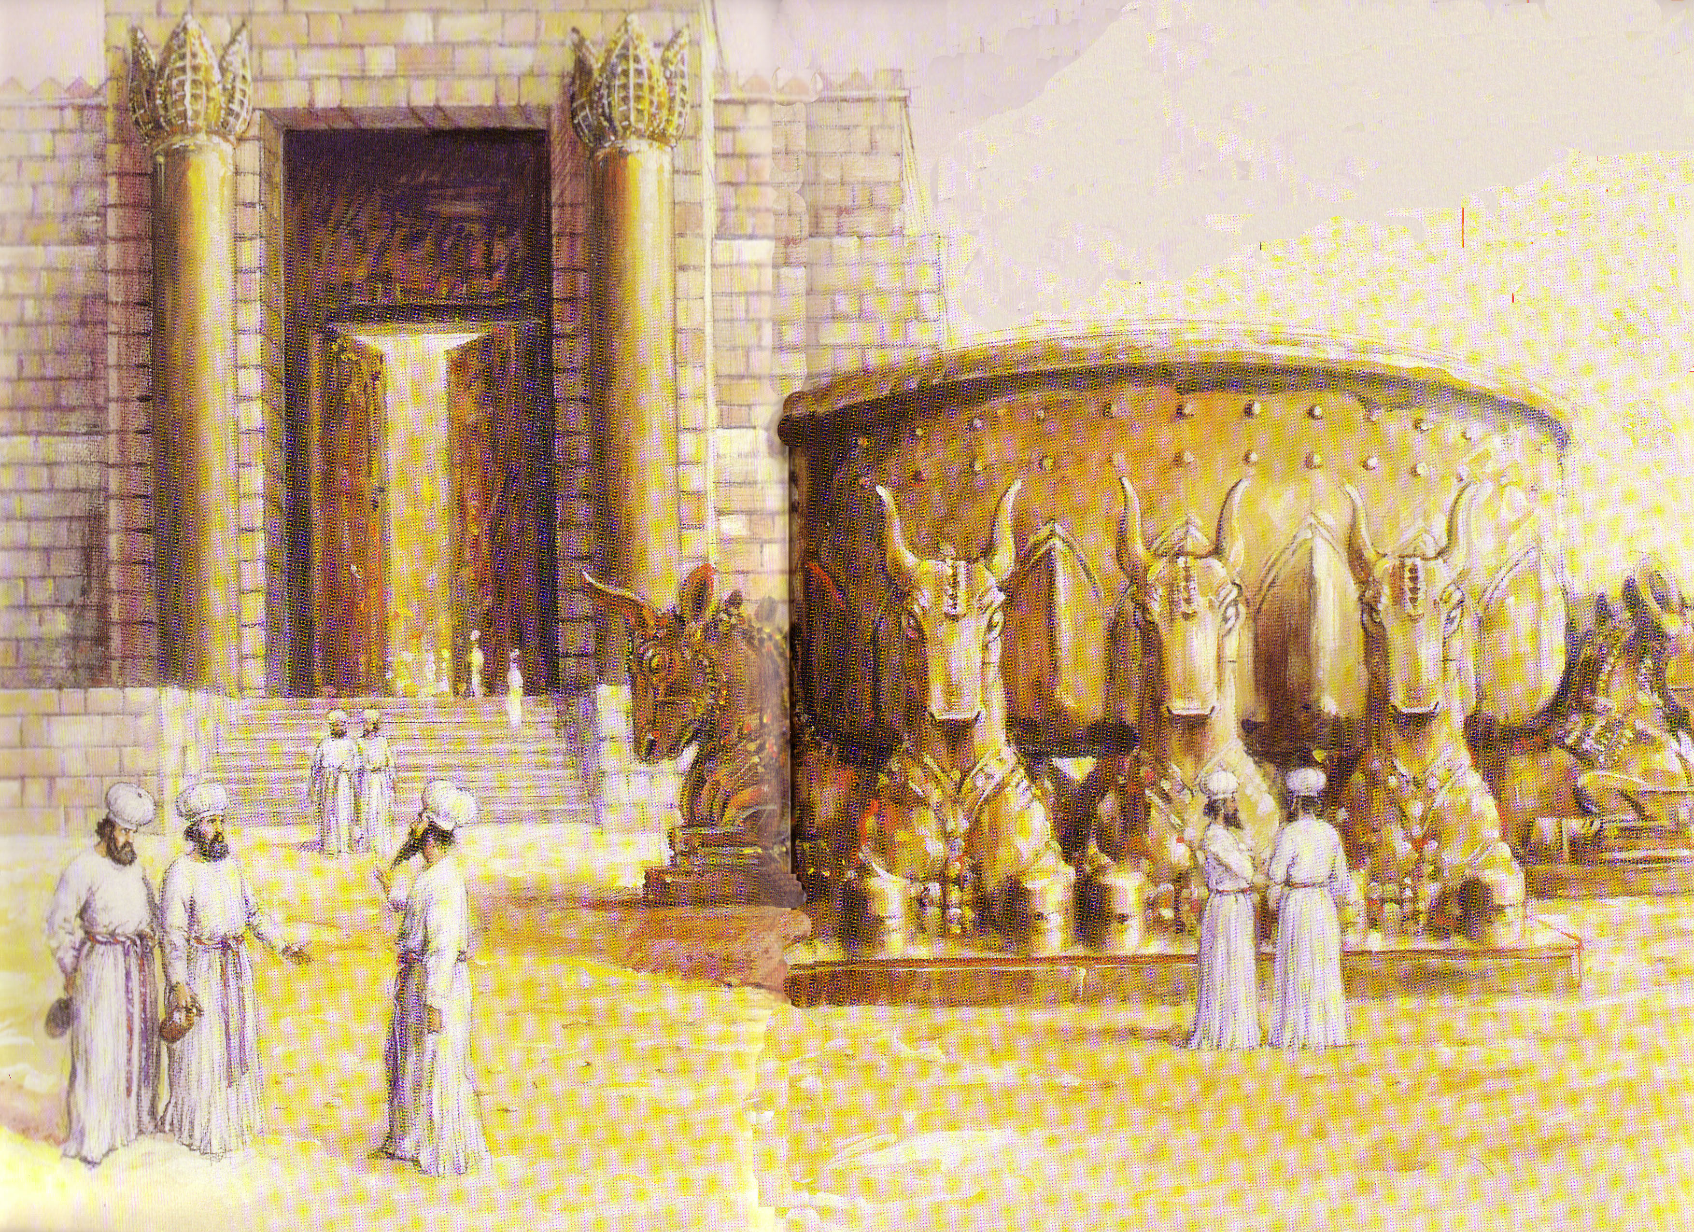
God's Presence Indwelt Solomon's Temple

Slide 26
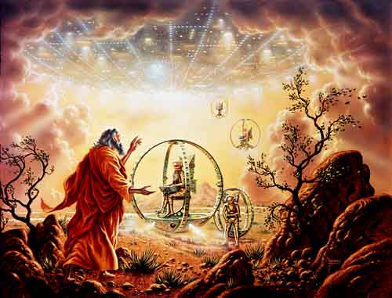
Ezekiel 1

Slide 27
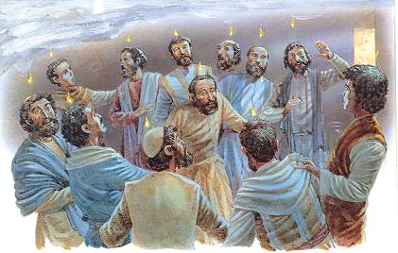
What happened at Pentecost?

Slide 28
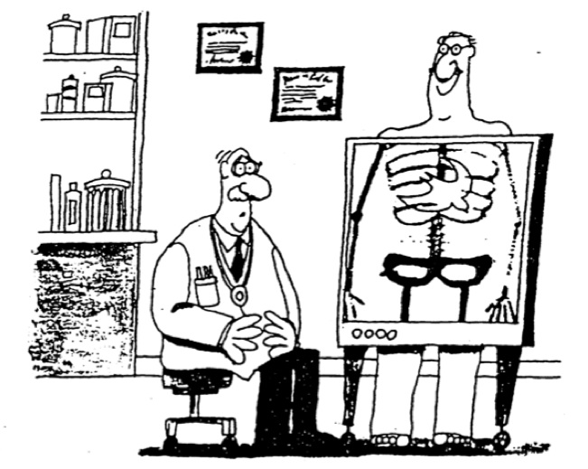

The Indwelling Spirit

Slide 29
Black
Notes:
29

Slide 30
I. Immorality harms your relationship with God
(12-14, 17, 19-20)
Why purity?

Slide 31

II. Immorality harms your relationship with others (15-16)
Why purity?

Slide 32
Black
Notes:
32

Slide 33
I. Immorality harms your relationship with God
(12-14, 17, 19-20)
Why purity?

Slide 34
II. Immorality harms your relationship with others (15-16)
Why purity?

Slide 35

III. Immorality harms your relationship with yourself (18).
Why purity?

Slide 36
Black
Notes:
36

Slide 37

The CO$T of “Free Sex”

Slide 38
Black
Notes:
38

Slide 39

Avoid sexual immorality because it harms your relationship with God, others, and yourself
––The Main Idea ––

Slide 40
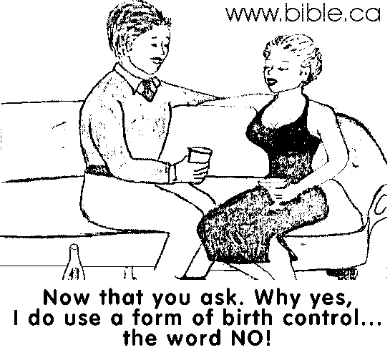
How can you avoid immorality?
Flee (v. 18)!
Now that you ask, why, yes, I do use a form of birth control…
the word NO!
Notes:
40

Slide 41
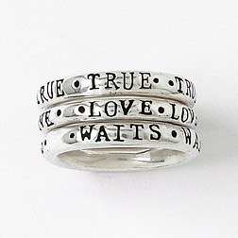

How can you avoid immorality?
Commit (v. 20)!
Notes:
41

Slide 42

For those married…
Commit (v. 20)!
“Marriage should be honored by all, and the marriage bed kept pure, for God will judge the adulterer and all the sexually immoral" (Heb. 13:4)
Notes:
42

Slide 43
Black
Notes:
43

Slide 44


NT Preaching link at BibleStudyDownloads.org
Get this presentation and script for free!
Notes:
NT Preaching (np)

